Slide 1

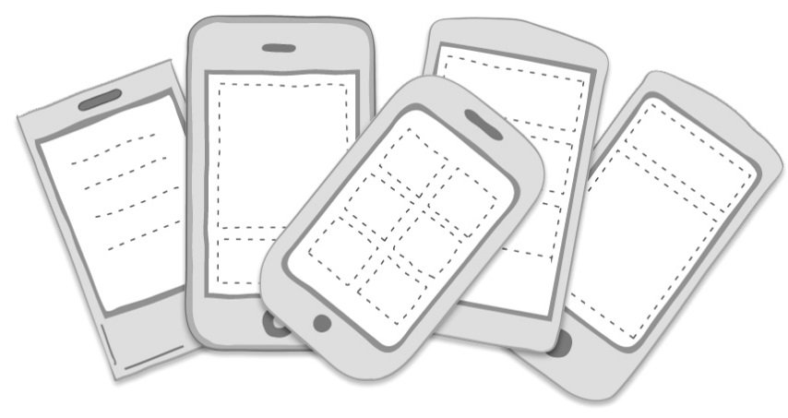
19CS414-Mobile App Development
Unit III
ADVANCED DESIGN
Design patterns for mobile applications

Slide 2
Why Design Pattern?
Design patterns are commonly defined as time-tested solutions to recurring design problems.
Design patterns are used to represent some of the best practices adopted by experienced object-oriented software developers.
A design pattern describes the problem, the solution, when to apply the solution, and its consequences.
It also gives implementation hints and examples.
Over 20 years ago the iconic computer science book Design Patterns: Elements of Reusable Object-Oriented Software was first published and still continues to be the best seller.
The four authors of the book: Erich Gamma, Richard Helm, Ralph Johnson, and John V lissides, have since been dubbed The Gang of Four. In technology circles, you’ll often see this nicknamed shorted to GoF.

Slide 3
Design Patterns in Application Development
Which architectural to follow from MVC/MVP/MVVM/Redux etc. when creating a new module or application?
Do you need to use a design pattern while instantiating the class? How will you choose from Singleton/Factory/Builder etc. based on your requirement?
What design pattern you will need while making up the object Adopter/Bridge/Composite or something else?
How will you properly set up the relation between objects based on your requirements? Will you use Command/Iterator/Observer or something else?

Slide 4
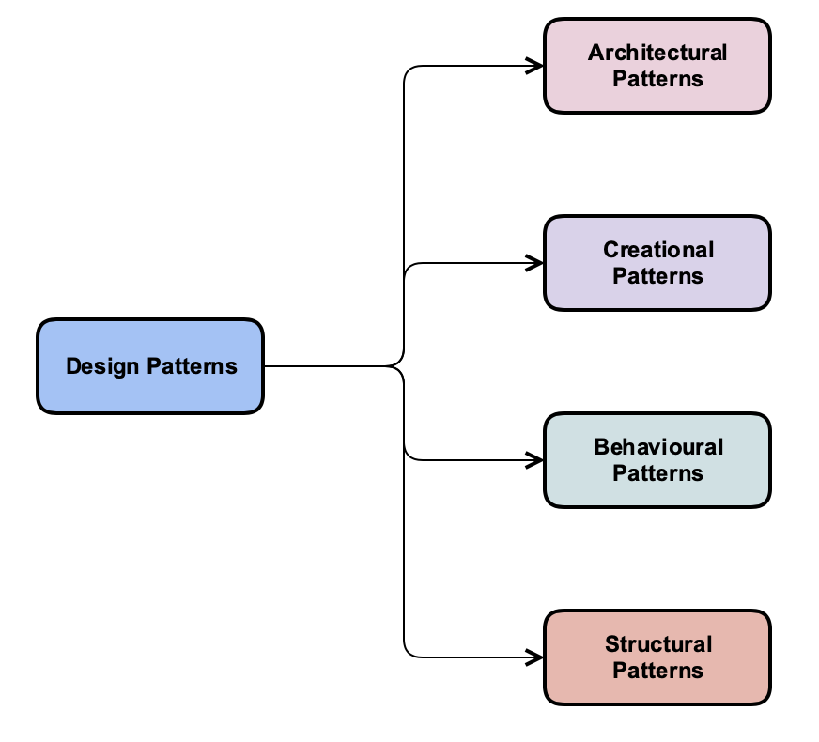
Types of Design Patterns
There are mainly four categories of Design patterns in mobile applications.
Architecture
Creational
Structural
Behavioral

Slide 5
Architecture Design Patterns
Architecture design patterns deal with the architecture of application or module.
Architecture design patterns have focused on the architecture of the application and how responsibilities between different modules/components can be defined based on requirements.
Below are the types of architecture design patterns used for building UI applications. :
Model View Controller (MVC): It divides the application into three separate entities Data model, View or UI, and Controller.
Model View Presenter (MVP): Unlike MVC, all the presentation logic moves to the presenter.
Model View View-Model (MVVM): View model is responsible for exposing the data objects from the model in such a way that objects are easily managed and presented.
VIPER: This design pattern implements the separation of concern paradigm and makes the application structure more modular
Redux: In Redux all of your app’s state lives in one container. The only way to change the state is to create a new state based on the current state and a requested change.

Slide 6
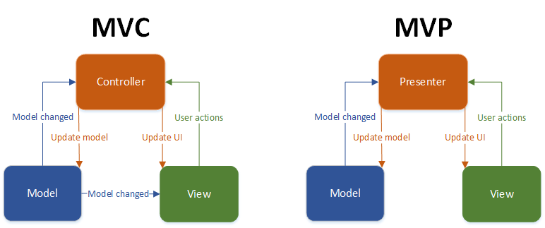

Slide 7
Creational Patterns
Creational design patterns deal with the creation of new objects.
Creational design patterns are composed of two dominant ideas.
One is encapsulating knowledge about which concrete classes the system uses.
Another is hiding how instances of these concrete classes are created and combined.
Below are types of creational design patterns:
Builder: Creational design pattern used to build the object in steps.
Factory Method: Define an interface for creating an object, but let the classes which implement the interface decide which class to instantiate.
Abstract Factory: Provide an interface for creating families of related or dependent objects without specifying their concrete classes
Static Factory: The static factory method is simply a static method that returns an instance of a class.
Singleton: Design pattern to provide only a single instance of the class.
Prototype: Prototype means making a clone.In this design pattern instead of making new objects we clone already created objects of the same properties.

Slide 8
Structural Patterns
Structural design patterns deal with the makeup of actual objects itself.
Structural design patterns focus on, how the classes inherit from each other and how they are composed of other classes.
Structural patterns use inheritance to compose interface or implementations.
Below are types of structural design patterns:
Adapter: Convert the interface of a class into another interface clients expect. An adapter lets classes work together that couldn’t otherwise because of incompatible interfaces.
Bridge: Decouple an abstraction from its implementation so that the two can vary independently.
Composite: Compose objects into tree structures to represent part-whole hierarchies. Composite lets clients treat individual objects and compositions of objects in the same way.
Decorator: Attach additional responsibilities to an object dynamically. Decorators provide a flexible alternative to subclassing for extending functionality.
Facade: Provide a unified interface to a set of interfaces in a subsystem. Facade defines a higher-level interface that makes the subsystem easier to use.
Flyweight: Use sharing to support large numbers of fine-grained objects efficiently.
Proxy: Provide a surrogate or placeholder for another object to control access to it.

Slide 9
Behavioral Patterns
Behavioral design patterns deal with how objects relate to each other.
Behavioral design patterns have focused on the assignment of responsibilities between objects, or, encapsulating behavior in an object and delegating requests to it.
Below are types of behavioral design patterns:
Command: Encapsulate a request as an object, thereby letting you parameterize clients with different requests, queue or log requests, and support undoable operations.
Iterator: Provide a way to access the elements of an aggregate object sequentially without exposing its underlying representation.
Observer: Define a one-to-many dependency between objects so that when one object changes state, all its dependents are notified and updated automatically.
State/ Objects for States: Allow an object to alter its behavior when it’s internal state changes. The object will appear to change its class.
Template: Template Method lets subclasses redefine certain steps of an algorithm without changing the algorithm’s structure.

